Slide 1
Unit 8
Is there a post office near here?
Section B 2a-2c
七年级(下)

Slide 2

Objectives
Read the passages from Anna, John and Lisa to get the detailed information
To learn to write a passage according to a map using prepositions of place
To learn new words: neighborhood, spend, climb, road, often, sunshine, enjoy…

Slide 3
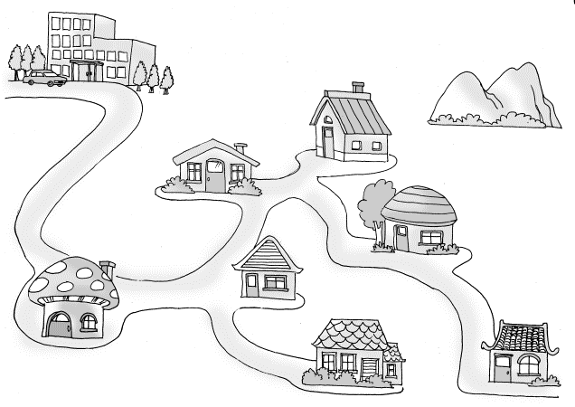
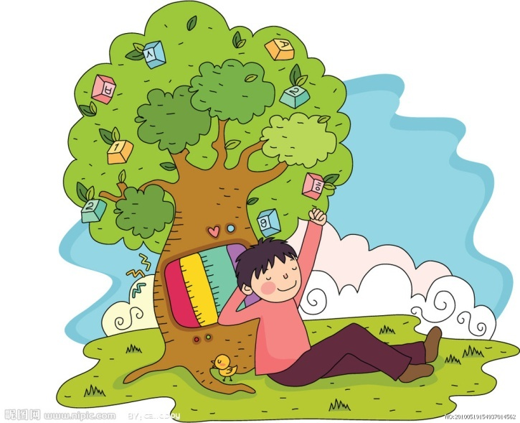
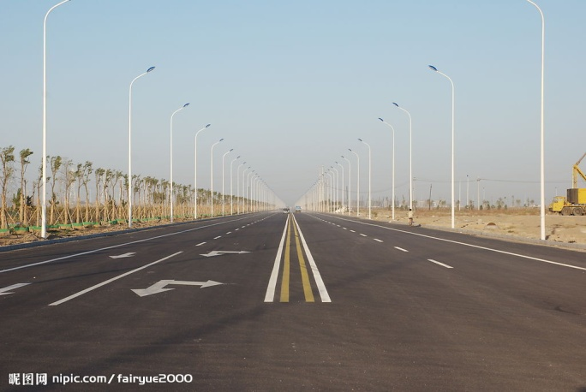
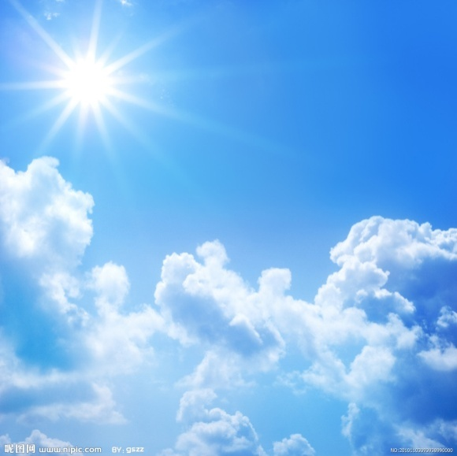
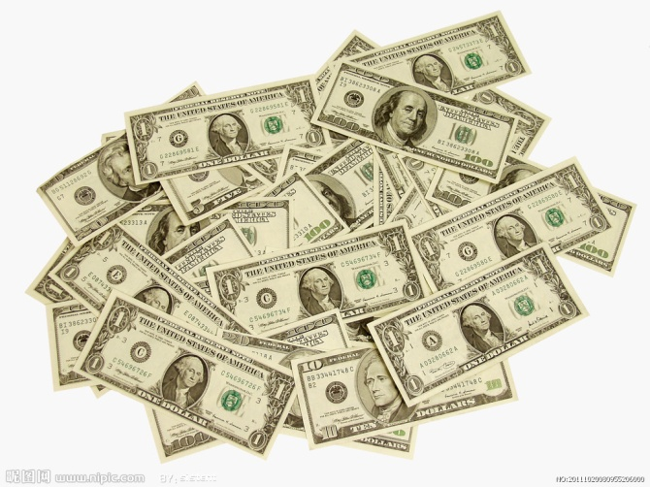
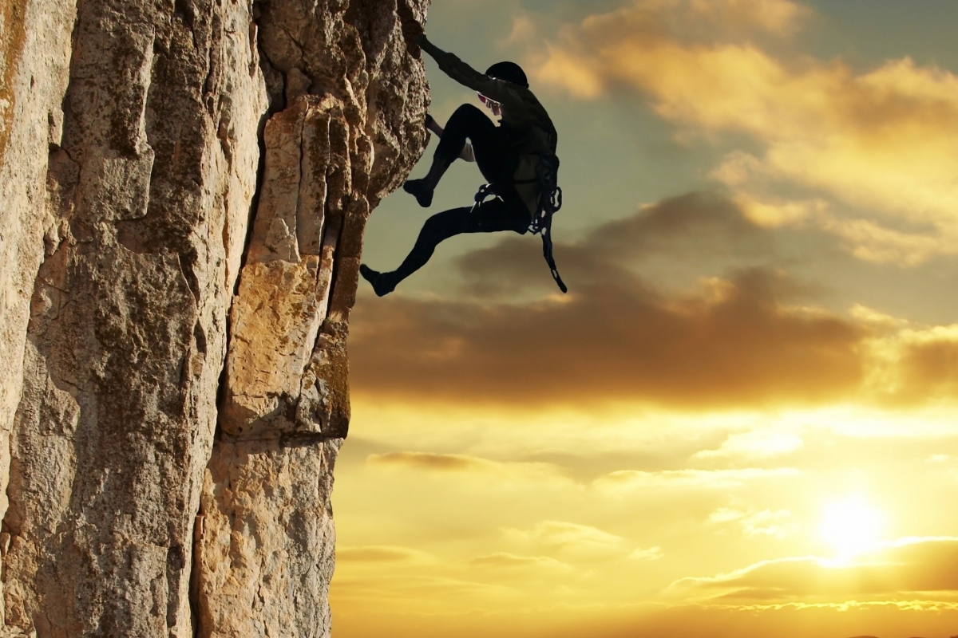

Main words
neighborhood
road
enjoy
climb
sunshine
money

Slide 4
Talking
2a Check (√) the places near your
home. Tell your partner where
they are.
clothes store post office
bookstore school
supermarket bank
√
√
√
√
√
√

Slide 5
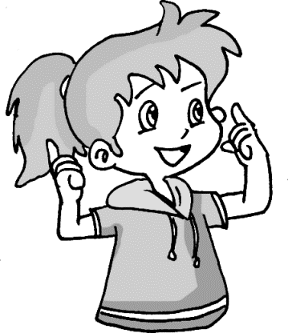
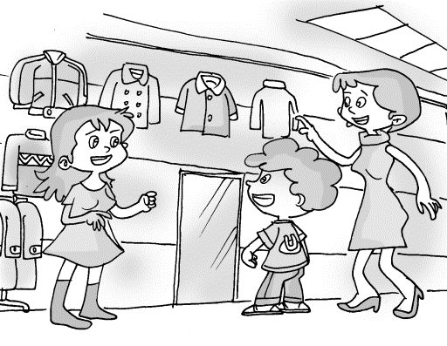
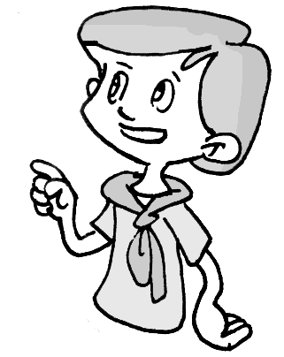
There is a clothes store near my home.
Where is it?
It’s next to the bank on Bridge Road.

Slide 6
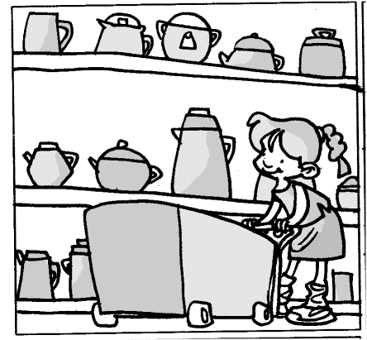
There is a supermarket near my home.
Where is it?
It’s behind the school on Long Street.

Slide 7


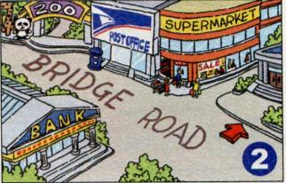
2b. Read the passages. Match each
passage with a map.
Anna
There is a zoo in my neighborhood. I like to
spend time there on weekends. I love to watch
the monkeys climbing around. The monkeys
sometimes fight. They look like my friends
and me when we fight!
To get there, I usually walk out and turn
right on Bridge Road. Then I walk
along Bridge Road. The zoo
is on the right.

Slide 8
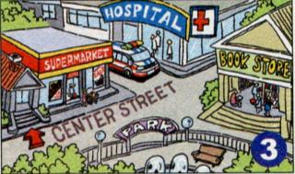
John
I live near a supermarket. My parents usually
shop there. There is a big park across from
the supermarket. I often exercise at the park
because I love the clean air and sunshine.
The best things in life are free!
To get to the park, you just have to
cross Center Street.

Slide 9
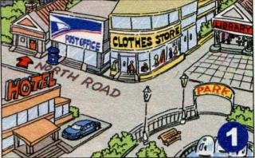
Lisa
I live in a noisy neighborhood. There is a post
office between my house and a clothes store.
But my favorite place is the library. It is
very quiet and I enjoy reading there. When I
read books, time goes quickly!
You can get to the library easily.
Just go down North Road and turn left.
It is across from the park.

Slide 10
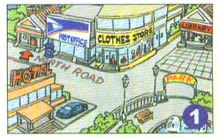
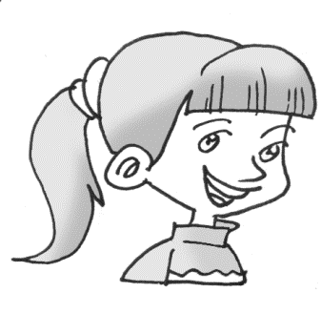
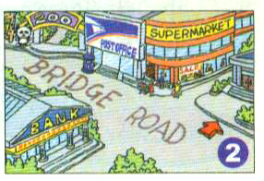
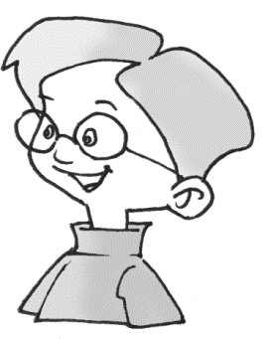
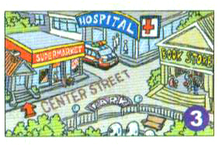
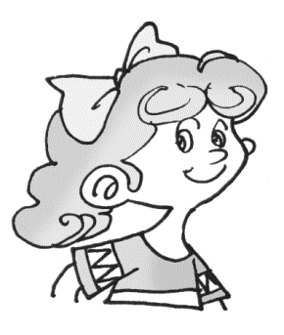

Reading
Read the passages. Match each passage with a map.
Anna
John
Lisa

Slide 11
Read the first passage and answer the
questions.
Where does Anna like to spend time on
weekends?
___________________________________
2. What animal does Anna love to watch?
___________________________________
3. How does Anna get to the zoo?
___________________________________
___________________________________
She likes to spend time in the zoo.
She loves to watch monkeys.
Turn right on Bridge Road. Then walk along Bridge Road. The zoo is on the right.

Slide 12
Read the second passage and answer the questions below.
1. Where does John live?
_______________________________
2. Where is the big park?
______________________________
3. Where does John often exercise?
______________________________
4. How does John get to the park?
_______________________________
He lives near a supermarket.
It’s across from the supermarket.
He often exercises in the park.
He has to cross the Center Street.

Slide 13
Read the third passage and answer the questions below.
Where is the post office?
_______________________________
_______________________________
2. What’s Lisa’s favorite place?
______________________________
3. Can Lisa get to the library easily?
______________________________
It is between Lisa’s house and a clothes store.
The library.
Yes, she can.

Slide 14
2c. Read the passages again and
answer the questions.
1. What does Anna like doing in the zoo?
2. Does Anna think monkeys are like
people? Why?
3. What does John like to do at the park?
4. John thinks the best things do not need
money. Do you think so, too?
5. How does Lisa get to the library from
her home?

Slide 15
A n s w e r s
1. Anna likes watching the monkeys climbing around.
2. Yes. Anna thinks that when the monkeys are fighting, they look like her friends fighting.
3. John likes to exercise at the park.
4. Yes. I agree with John.
5. Lisa walks to the library. She goes down North Road and then turns left. The library is across from the park.

Slide 16
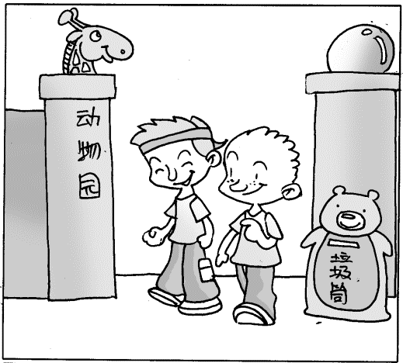
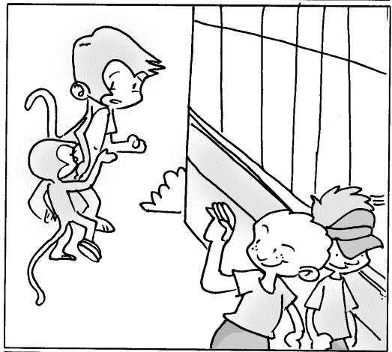
Tell something about Anna.
Bridge Road
There is a zoo in Anna’s neighborhood. She likes to spend time there on weekends. She loves to watch the monkeys climbing around. The monkeys sometimes fight.
To get there, she usually walks out and turns right on Bridge Road. Then she walks along Bridge Road. The zoo is on the right.

Slide 17
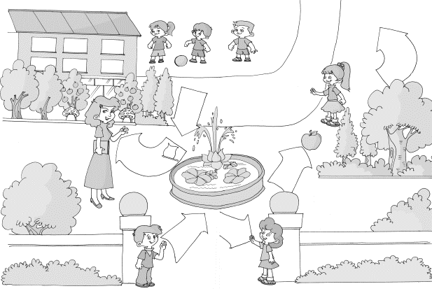
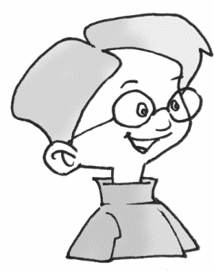
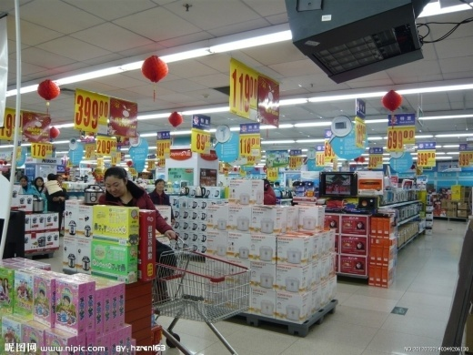
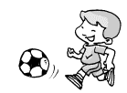
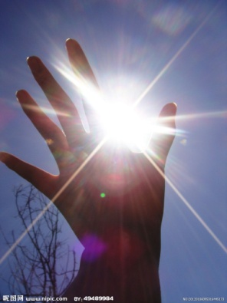
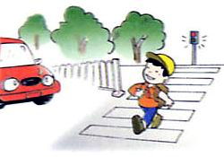
Tell something about John.
John lives near a supermarket. His parents usually shop there. There’s a big park across from the park. He often exercises in the park because he loves the clean air and sunshine.
To get to the park, he has to cross the Centre Street.

Slide 18
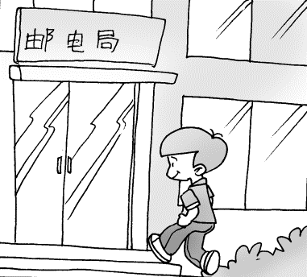
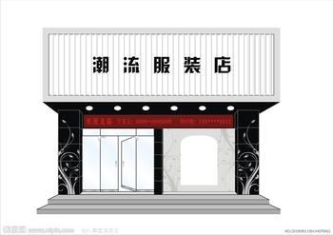
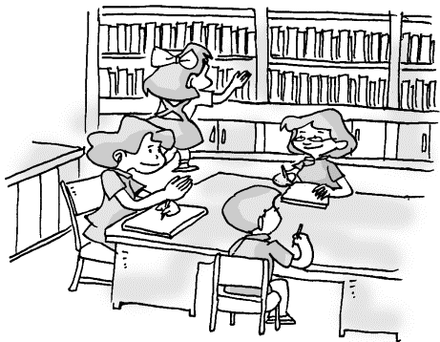
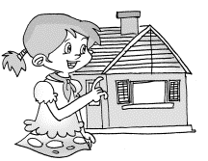
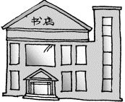
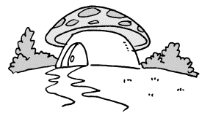
Tell something about Lisa.
Lisa lives in a noisy neighborhood. There is a post office between her house and a clothes store. But her favorite place is the library. It is very quiet and she enjoys reading there. When she reads books, time goes quickly.
To get to the library easily, just go down North Road and turn left. It’s across from the park.
North Road

Slide 19
Language points
1. neighborhood 意为“附近;附近地区;街坊”
e.g. 我的街坊们都很友好。
My neighborhoods are friendly.
in the neighborhood 在附近
e.g. 在附近有一家中国餐馆。
There is a Chinese restaurant in the
neighborhood.

Slide 20
2. To get to the park, you just have to
cross Center Street.
to get to the park 是目的状语前置，此
句中的just起增强语气的作用，此处的
have to表示“只要，仅需”。

Slide 21
3. It is very quiet and I enjoy reading there.
enjoy 表示“从中得到乐趣；欣赏；喜欢”，
后接动词时候，动词用-ing形式，即enjoy
doing…,表示喜欢做某事，享受做某事带来
的乐趣。
e.g. I enjoy listening to soft music.
我喜欢听轻柔的音乐。
拓展:enjoy oneself 表示 “玩的高兴，愉快”
e.g.: Our classmates enjoy ourselves.

Slide 22
4. Take a walk through the park
在公园里散散步。
walk在短语中的词性是名词，
talk a walk 意为“散步”。through是介词，
意思是“穿过, 从……中通过”。
链接: (1) walk在英语中有两种词性, 例如：
作名词，take a walk / go for a walk 散步 ;
还可以作动词，walk to school 走路上学。

Slide 23
(2) across/through/over
这三个词都有“穿过, 通过”的意思，但
across它着重从某物的表面“横过，穿过，
从一边到另一边”；而through 强调从空间
内的一头纵穿到另一头，意思是“穿过，
从……中通过”, over多指从物体上空通过。

Slide 24
例如：
They walk across the bridge.
他们步行走过了这座桥。
He walks through the park.
他步行穿过公园。
The birds fly over the city.
鸟儿从城市上空飞过。

Slide 25
用across和through填空。
Go ______ the bridge.
Light comes in _________ the window.
across
through
解析: “穿过桥”是从桥的表面横跨；
“光线透过窗户照进来”强调光从窗户中
通过。

Slide 26
5. spend 花费（时间、金钱等）。
1) spend + (时间、金钱) + on sth.
e.g. 杰克每天花很多时间做作业。
Jack spends a lot of time on his homework.
2) spend + (时间、金钱) + doing sth.
e.g. 我妹妹每天花很多时间读书。
My sister spends much time reading books.
4. money 是不可数名词, 作单数看
e.g. 钱是重要的，但并不是一切。
Money is important, but it isn’t everything.

Slide 27
6. free “免费的”
e.g. 这些书都是免费的。
These books are free.
【拓展】free 空闲的；（反义词）busy
e.g. 格林先生本周不忙。
Mr. Green isn’t busy this week.
或(Mr. Green is free this week.)

Slide 28
7. easily 容易地 (副词)(easy + ly →easily)
e.g. 公共汽车站离这里很近，你可以容易
找到它。
The bus stop is not far from here.
You can find it easily.

Slide 29
8. To get there, I usually walk out and
turn right on Bridge Road.
这是英语行文的一种方式，在句子开头用to do…短语，并用逗号将其与句子的主体部分隔开，相当于汉语“（若）要做……的话”。
e.g. To listen to world news, please key
in “1”.
若要收听国际新闻，请键入“1”。

Slide 30
一、熟读2b中的三篇小短文。
二、用下列词汇造句子：
1. in the neighborhood 2. spend …on…
3. walk along/down 4. on the right
5. be free 6. enjoy doing sth.
7. turn left 8. climb
Homework

Slide 31
Thank You!

